Slide 1


Slide 2

“Money is the root of all evils”

Slide 3

Bank Management System
A Java
Project
September
2021

Slide 4



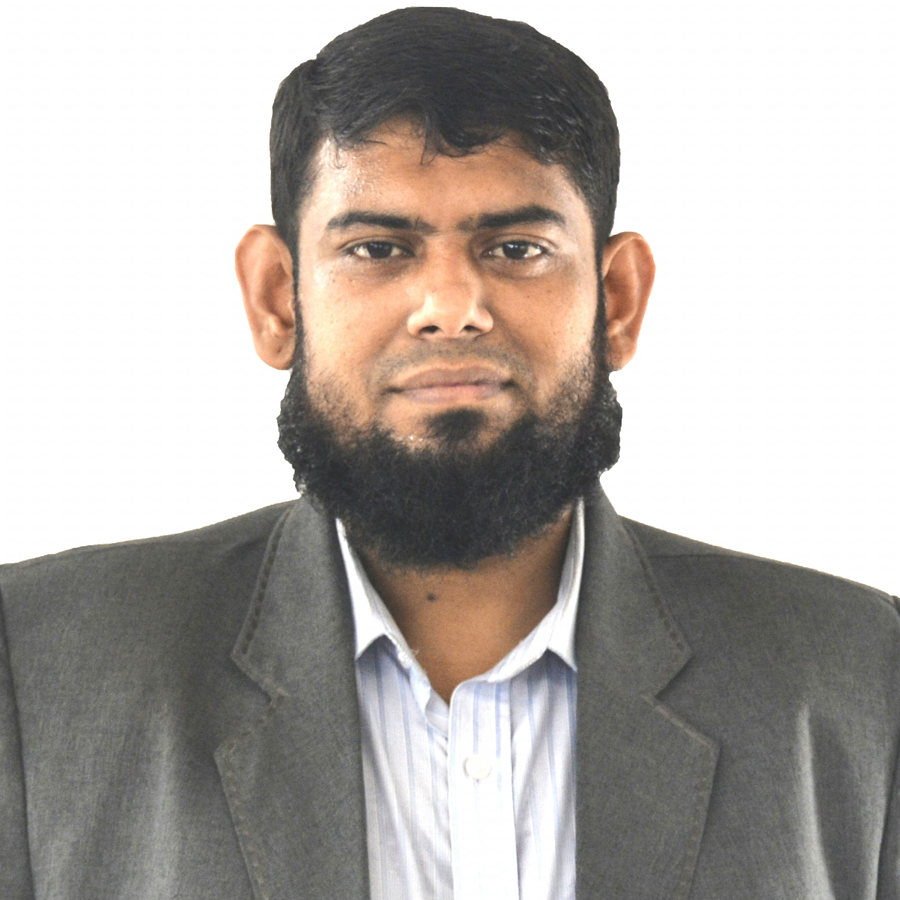
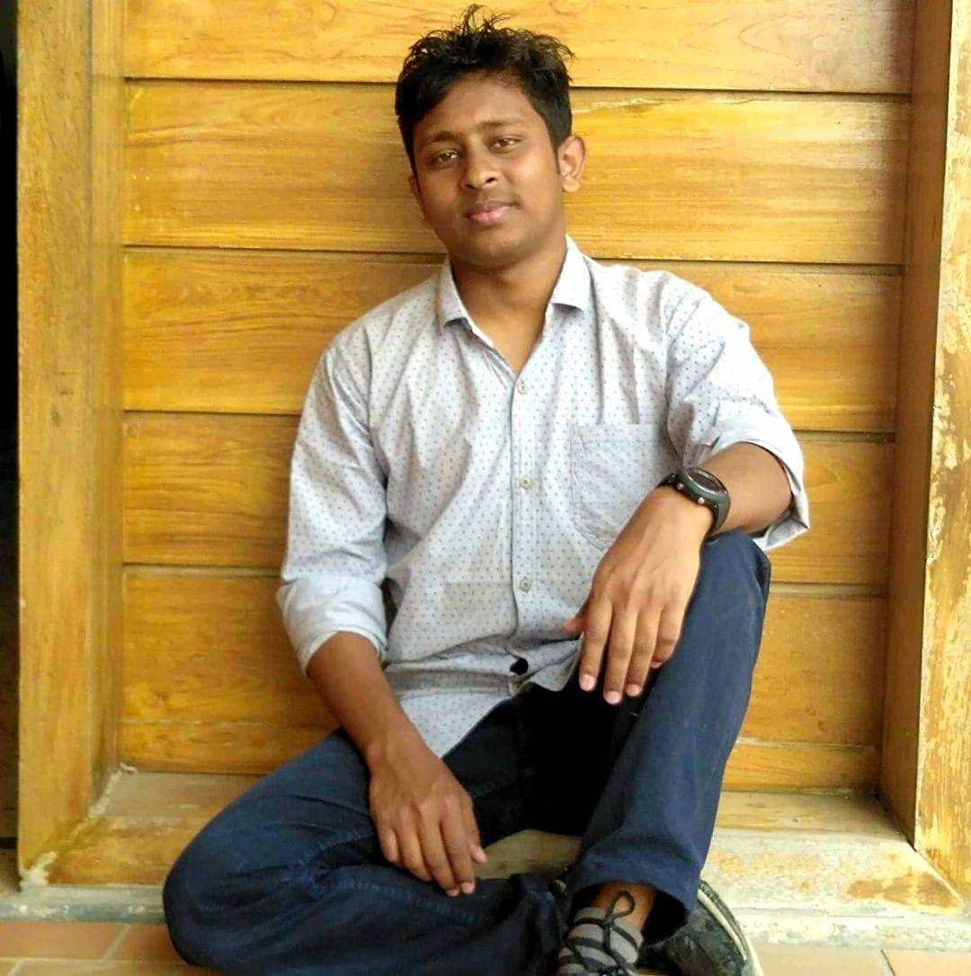
Green University of Bangladesh
Presented by:
Presented To:
Md. Adnan Abir
ID: 202902035
Nura Anha Tamanna
ID: 202902002
Md. Solaiman Mia
Assistant Professor
Department of CSE
Mahede Hasan
ID: 202902012

Slide 5

INTRODUCTION
The project that we have undertaken aims to develop a banking system that is clean, user friendly and multi-functional.
Transactions can be done .
Transactional details and accounts are stored.
Can view their own account details and can use them.
All customer’s data are stored safely.
This system possesses is protected.
Secure and save transaction for better performance.
Reducing man power for doing work more accurately.
Faster performance.

Slide 6
BACKGROUND OF PROJECT
It is used by the bank authority to manage the whole system using a computerized system where authority can record various information of client and manage their account.
Increasing number of profit is visible in banks after using Computerized management system

Slide 7

SYSTEM DESIGN
A smart and elegant design
Start Menu
Ask for Customer Number
Customer
Details
Account No.
Full Name
Amount
Display All
Control
Panel
search
LOG OUT
Deposit
Withdraw

Slide 8
PRODUCT DESCRIPTION
The Bank Management System is an application for maintaining a person’s account in a bank. The system provides the access to the costumer to create an account, search for details, deposit/withdraw the cash from his account.

Slide 9
REQUIREMNETS
Functional Requirements:
Hardware Requirements:
Input customer total number
Open an account
View all account
Search your account
Update your fund details
Withdraw money
Deposit Money
Exit
Exit
Generally personal computer support java.
Java Compiler.
JDK

Slide 10

EXISTING VS PROPOSED SYSTEM
It will be able to overcome many human errors and will save time as well.
Existing system does not have any digital and secure facility for client’s where proposed system will have facilities of many digital accounting systems which will save time as well as reduce errors.
Existing system does not have any facility to generate all the particular information about the client’s information.

Slide 11
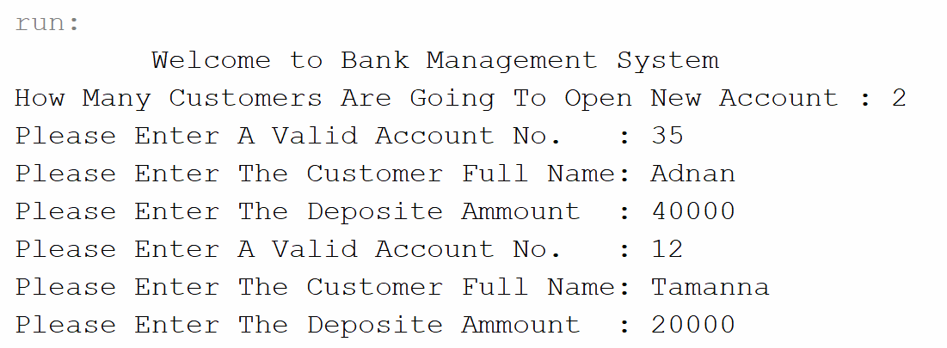
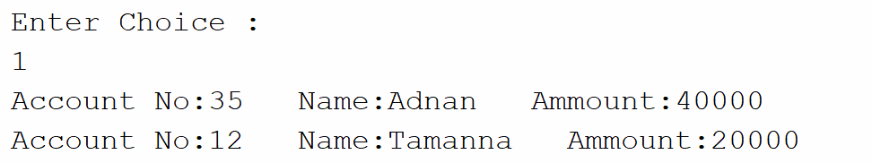
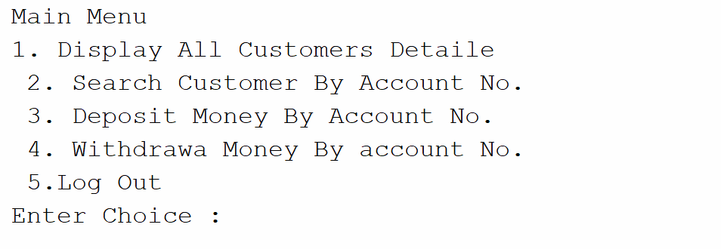
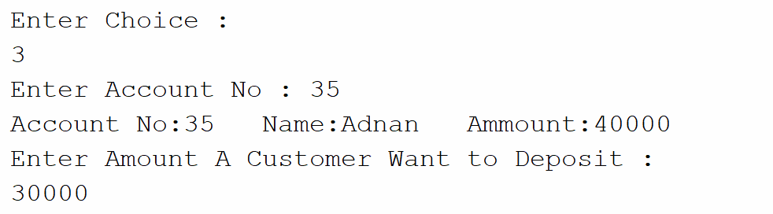
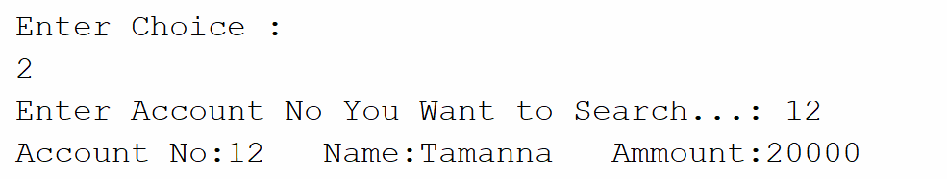
SYSTEM IMPLEMENTATION
Screen shots of several pages.

Slide 12
FUTURE SCOPE
It may used in any good bank for improving their facilities and reduce many human errors.
Log in panel for customers and admins.
Password protected.
More secure.
More attractive user interface
More Managing features.

Slide 13

CONCLUTION
We encourage other developers of similar application to think twice on how best they can improve in developing a more secured system that will meet the challenges we face today especially on the banking sector and other financial institutions.

Slide 14

THANK YOU!
Have a good day ☺
For more info, Please Email:
adnanabir35@gmail.com

